Slide 1

Functions
Straight lines
Notes:
Fonts: Brain Flower; Alte Haas Grotesk; Century gothic

Slide 2
Standard Form
y = m.x + c
y stand alone
[We write y in terms of m, x and c]
Notes:
Reguit lyne se standaard vorm is y=mx+c

Slide 3
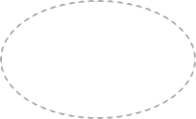
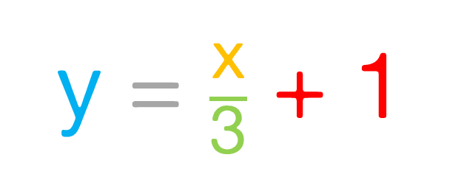
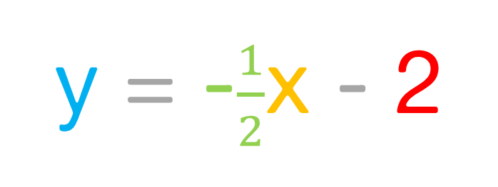
Examples of standard Form
y = 3x + 4
y = -$\frac{1}{2}$x - 2
y = $\frac{\text{x}}{\text{3}}$ + 1
y = x
y = -3
x = 3
Notes:
Ons skryf y in terme van m,x en c. Indien daar geen y is nie skryf ons x in terme van c.

Slide 4
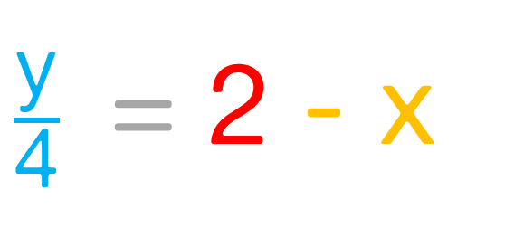
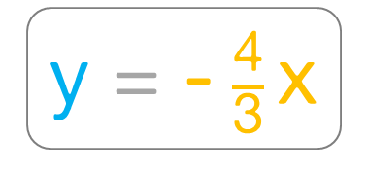
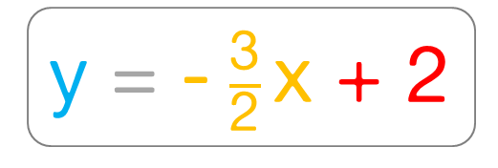
Write in standard form
3y = 3x + 6
2y + 3x = 4
y = x + 2
y = - $\frac{\text{3}}{\text{2}}$x + 2
$\frac{\text{y}}{\text{4}}$ = 2 - x
4x = -3y
y = -4x + 8
y = - $\frac{\text{4}}{\text{3}}$x
-x + y - 5 = 1
x - 3 = 0
y = x + 6
x = 3
Notes:
Skryf m as ‘n breuk nie as ‘n desimale getal nie. Jy sal later sien hoekom.

Slide 5
Drawing a Graph

Slide 6
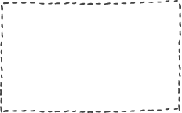
Table of values method
-1
-1
Choose input values
0
2
y = 3x + 2
1
5
Notes:
Onthou jy hierdie invoer/uitvoer vloeidiagram?
Ons kies x-waardes vir die invoer en kry y-waardes as uitvoer.
Ons kies gewoonlik x-waardes: -1;0;1

Slide 7
-1
-1
0
2
y = 3x + 2
1
5
x | -1 | 0 | 1
y | -1 | 2 | 5
coordinates:
(-1;-1)
(0;2)
(1;5)
Notes:
Ons kan die x- en y-waardes dan in ‘n tabel skryf en ko-ordinate kry.

Slide 8
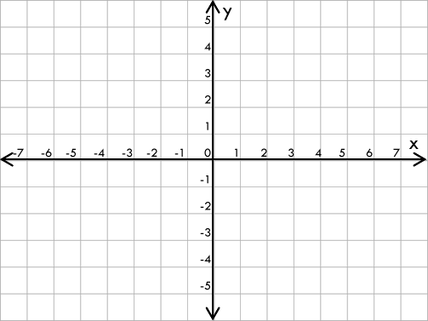
coordinates:
(-1;-1)
(0;2)
(1;5)
This is the line of the equation:
y = 3x + 2
I could choose any x-value and the line would still look the same:
x=-2
y = 3(-2) + 2
y = -4
(-2;4)
Notes:
Ons kan die ko-ordinate gebruik om punte op die cartetiese vlak te maak.
Ons kan die punte verbind en ‘n lyn trek.
Ons het dus y=3x+2 geskets met die tabel-metode.
Ek kon enige x-waardes gekies het en die lyn sal altyd dieslefde lyk.

Slide 9


Homework:
Ex 10.1 (p 202)
1. a,b,i
2.
4

Slide 10
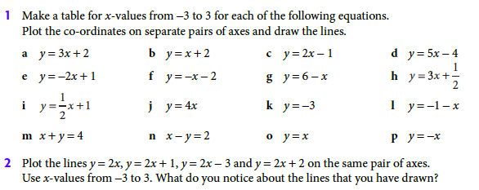
Homework: Ex 10.1 (p202)
5

Slide 11

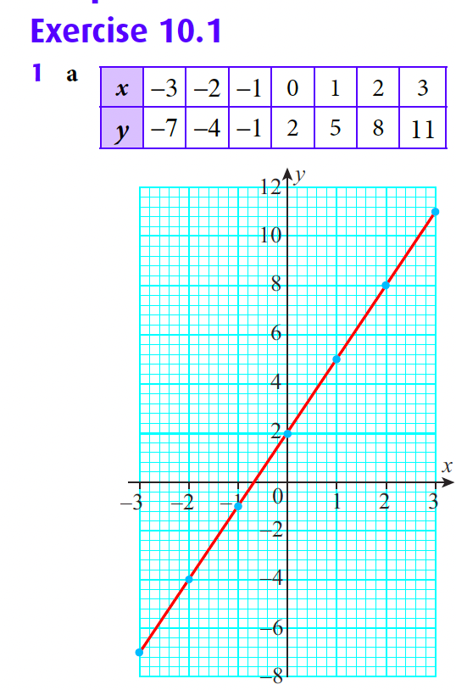
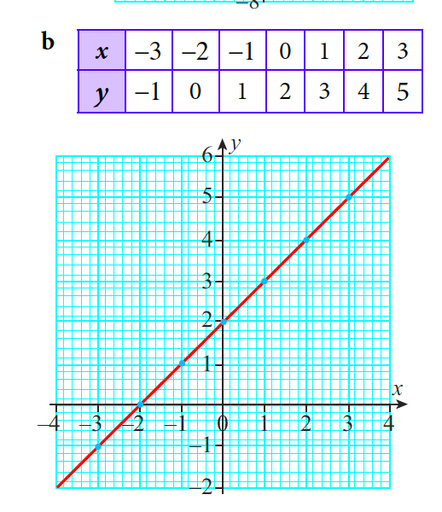
Homework: Ex 10.1 (p202)
5

Slide 12
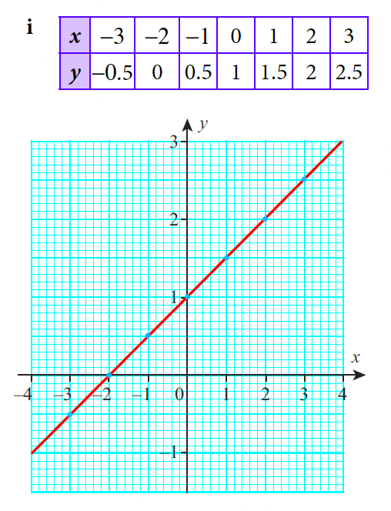
Homework: Ex 10.1 (p202)
5

Slide 13
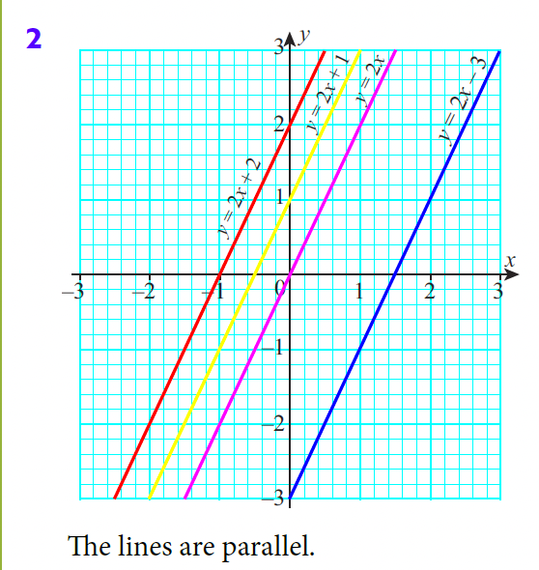
Homework: Ex 10.1 (p202)
5

Slide 14
Standard form
y = m.x + c
What is what?

Slide 15
Can you see it?
y = x
y = x-1
y = 2x
y = 2x+2
Notes:
Kan jy sien wat is die verskil tussen die reguit lyne?

Slide 16
What is the difference between the lines?
y = mx + c
The m determines the “angle” of the line:
m is the gradient or slope.
Notes:
Die gradiënt bepaal hoe styl die lyn is.

Slide 17
Gradients can be “+” or “-”
y = +x
y = -x
Positive gradient
Negative gradient
m = “+”
m = “-”
Notes:
Kan jy sien wat is die verskil tussen die reguit lyne?
LET WEL: Gradiënte kan positief of negatief wees.

Slide 18
What is the difference between the lines?
y = mx + c
The c is where the line crosses the y-axis.
c is the y-intercept. [it is + of –]
Notes:
Die c kan oof positief of negatief wees.
Positief bo die x-as.
Negatief onder die x-as.

Slide 19

Standard form
y = m.x + c
y/x
Input/output
m
Gradient
c
Y-intercept

Slide 20
Special lines
y=5
y=2
y=-2
Can you spot what stays the same with each line?
The y-value
Notes:
Die c kan oof positief of negatief wees.
Positief bo die x-as.
Negatief onder die x-as.

Slide 21
Special lines
x=-6
x=2
x=5
Can you spot what stays the same with each line?
The x-value
Notes:
Die c kan oof positief of negatief wees.
Positief bo die x-as.
Negatief onder die x-as.

Slide 22
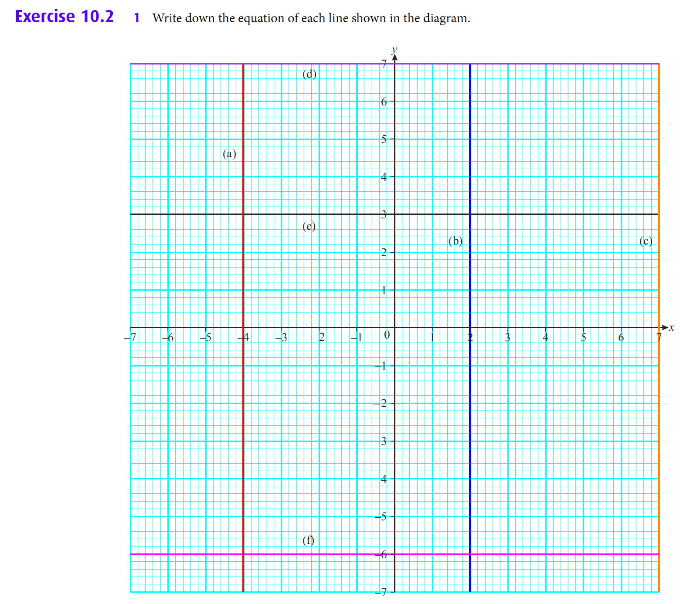
Homework: Ex 10.2 (p203)
5

Slide 23
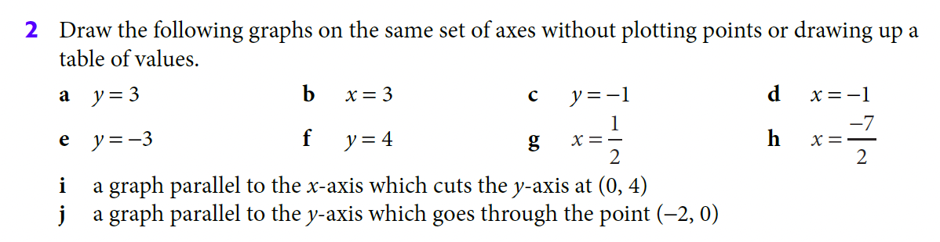
Homework: Ex 10.2 (p203)
5

Slide 24
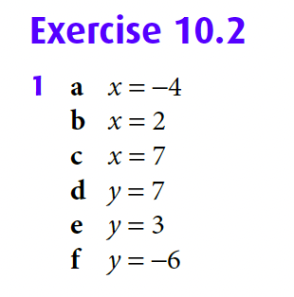
Homework: Ex 10.2 (p203)
5

Slide 25
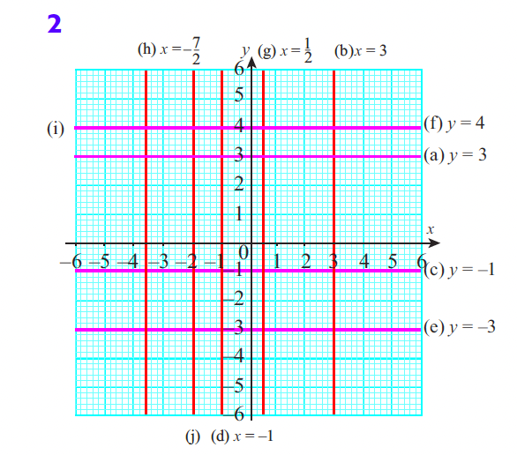
Homework: Ex 10.2 (p203)
5

Slide 27
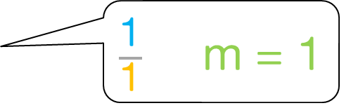
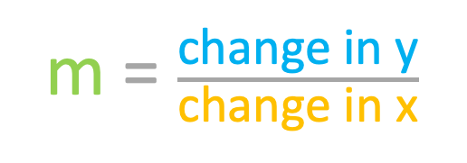
the gradient
m = $\frac{\text{change} \text{in} \text{y}}{\text{change} \text{in} \text{x}}$
$\frac{\text{1}}{\text{1}}$ m = 1

Slide 28
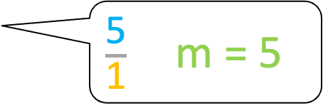
the gradient
m = $\frac{\text{change} \text{in} \text{y}}{\text{change} \text{in} \text{x}}$
$\frac{\text{5}}{\text{1}}$ m = 5

Slide 29
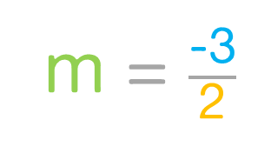
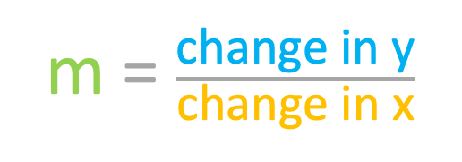
the gradient from a graph
m = $\frac{\text{change} \text{in} \text{y}}{\text{change} \text{in} \text{x}}$
m = $\frac{\text{−3}}{\text{2}}$

Slide 30
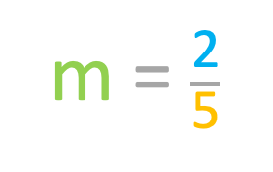
the gradient from a graph
m = $\frac{\text{change} \text{in} \text{y}}{\text{change} \text{in} \text{x}}$
m = $\frac{\text{2}}{\text{5}}$

Slide 31
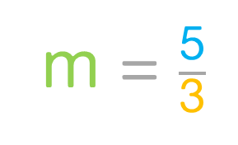
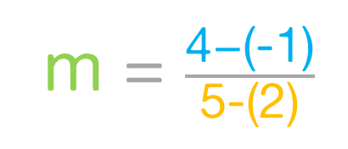
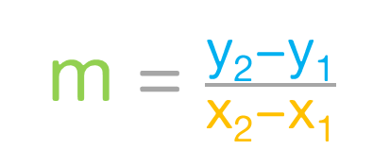
the gradient using two points
x2
y2
m = $\frac{\text{change} \text{in} \text{y}}{\text{change} \text{in} \text{x}}$
(5;4)
m = $\frac{\text{y}\text{2}\text{−}\text{y}\text{1}}{\text{x}\text{2}\text{−}\text{x}\text{1}}$
(2;-1)
m = $\frac{\text{4−(−1)}}{\text{5−(2)}}$
x1
y1
m = $\frac{\text{5}}{\text{3}}$

Slide 32
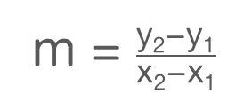
the gradient
You can work out the gradient if any of the following
is given:
2 coordinates:
Sketch with 1 coordinate and a y-intercept:
Sketch with 2 intercepts:
m = $\frac{\text{y}\text{2}\text{−}\text{y}\text{1}}{\text{x}\text{2}\text{−}\text{x}\text{1}}$
Equation/rule/function:
Write in standard form and read the m-value
y = m.x + c

Slide 33
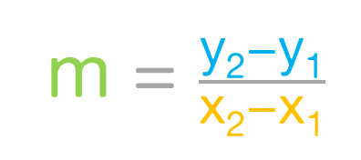
the gradient
m = $\frac{\text{y}\text{2}\text{−}\text{y}\text{1}}{\text{x}\text{2}\text{−}\text{x}\text{1}}$

Slide 34
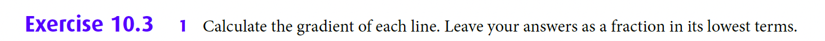
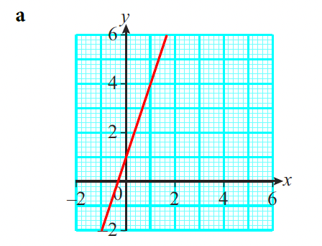
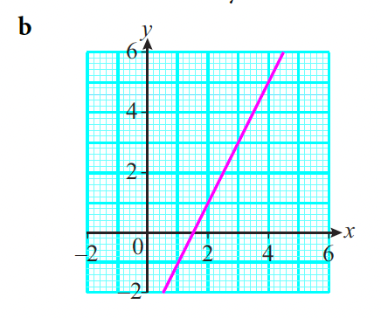
Homework: Ex 10.3 (p206)
5

Slide 35
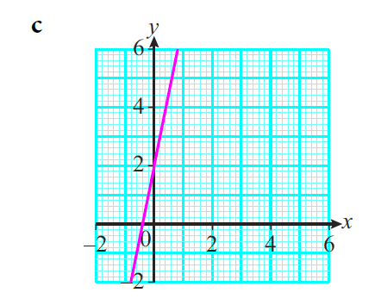
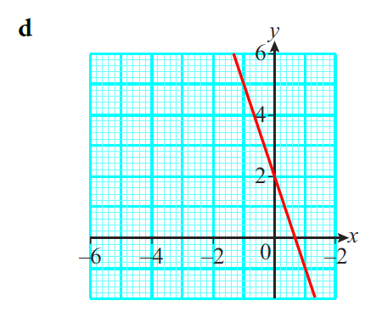
Homework: Ex 10.3 (p206)
5

Slide 36
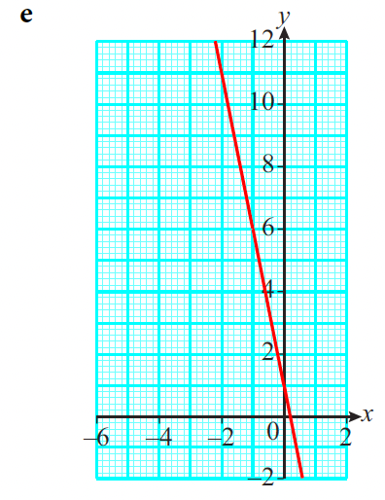
Homework: Ex 10.3 (p206)
5

Slide 37
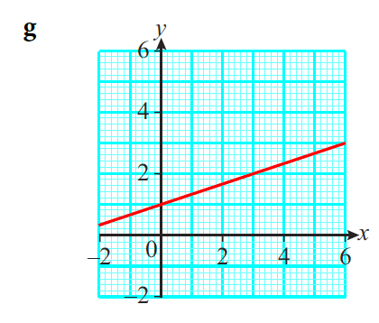
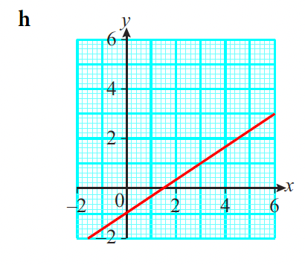
Homework: Ex 10.3 (p206)
5

Slide 38
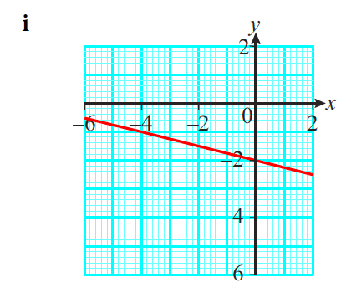
Homework: Ex 10.3 (p206)
5

Slide 39
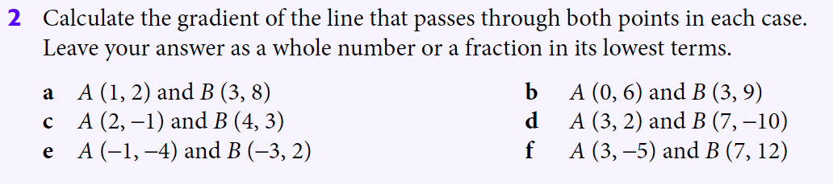
Homework: Ex 10.3 (p206)
5

Slide 40
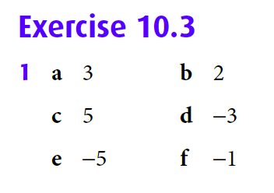

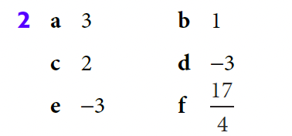
Homework: Ex 10.2 (p203)
5

Slide 41
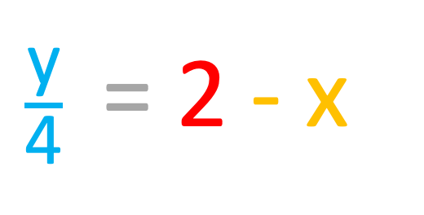
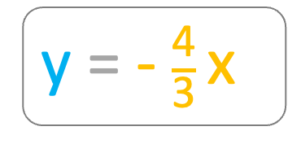
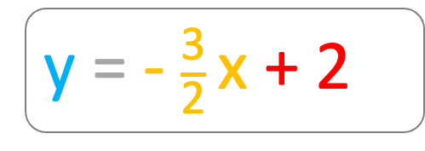
Give the gradient and y-intercepts for each line
3y = 3x + 6
2y + 3x = 4
y = x + 2
y = - $\frac{\text{3}}{\text{2}}$x + 2
$\frac{\text{y}}{\text{4}}$ = 2 - x
4x = -3y
y = -4x + 8
y = - $\frac{\text{4}}{\text{3}}$x
-x + y - 5 = 1
x - 3 = 0
y = x + 6
x = 3
Notes:
Skryf m as ‘n breuk nie as ‘n desimale getal nie. Jy sal later sien hoekom.

Slide 42
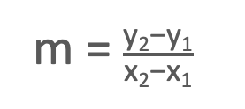
Gradient of Special lines
y=2
m=0
x=4
m=undefined
m = $\frac{\text{y}\text{2}\text{−}\text{y}\text{1}}{\text{x}\text{2}\text{−}\text{x}\text{1}}$
Notes:
Die c kan oof positief of negatief wees.
Positief bo die x-as.
Negatief onder die x-as.

Slide 43
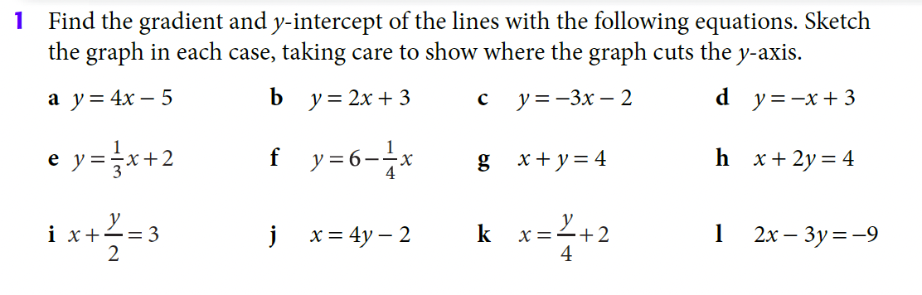
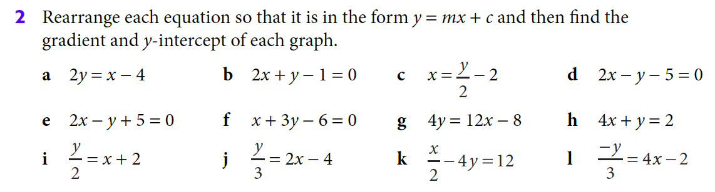
Homework: Ex 10.4 (p208)
5

Slide 44
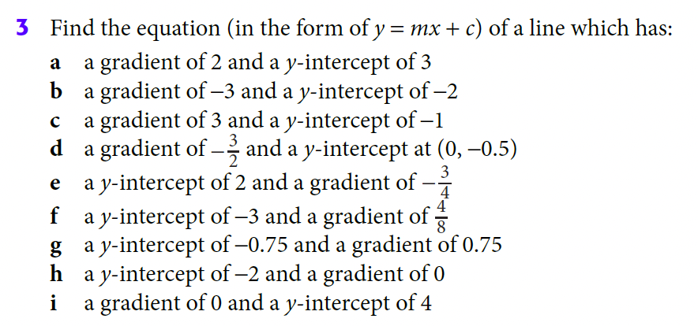
Homework: Ex 10.4 (p208)
5

Slide 45
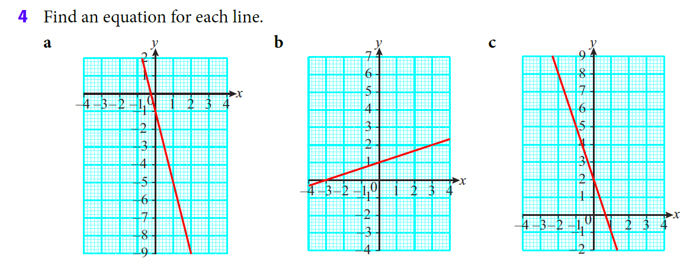
Homework: Ex 10.4 (p208)
5

Slide 46
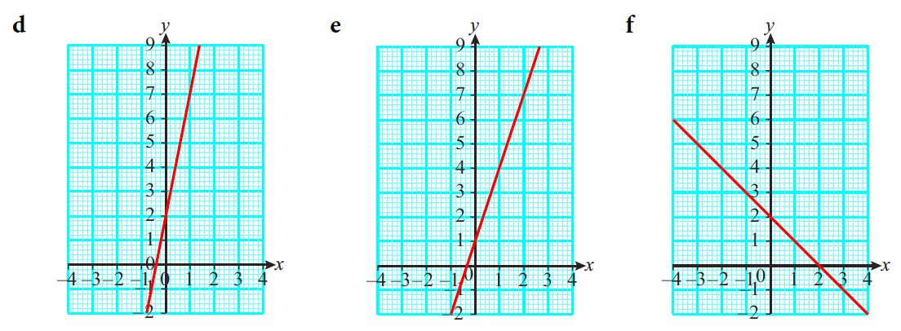
Homework: Ex 10.4 (p208)
5

Slide 47
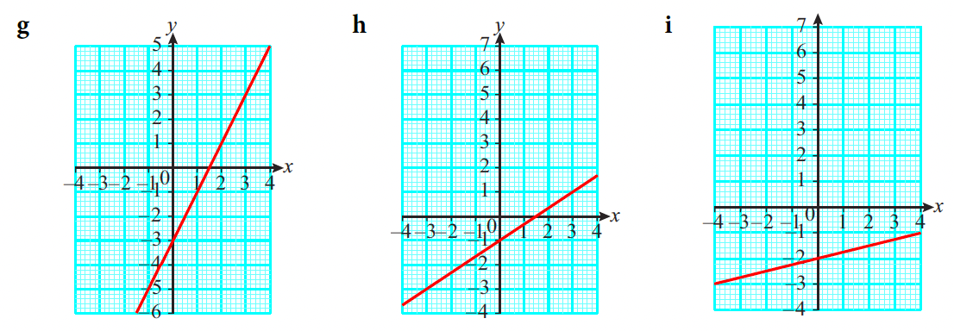
Homework: Ex 10.4 (p208)
5

Slide 48


Homework: Ex 10.4 (p208)
gradient = 4
y-intercept = –5
a) m = 4 c = –5
b) m = 2 c = 3
c) m = –3 c = –2
d) m = –1 c = 3
e) m = $\frac{\text{1}}{\text{3}}$ c = 2
f) m = $−\frac{\text{1}}{\text{4}}$ c = 6
g) m = $−$1 c = 4
h) m = $−\frac{\text{1}}{\text{2}}$ c = 2
i) m = $−2$ c = 6
j) m = $\frac{\text{1}}{\text{4}}$ c = $\frac{\text{1}}{\text{2}}$
k) m = 4 c = $−$8
l) m = $\frac{\text{2}}{\text{3}}$ c = 3
5

Slide 49


Homework: Ex 10.4 (p208)
gradient = 4
y-intercept = –5
5

Slide 50


Homework: Ex 10.4 (p208)
gradient = 4
y-intercept = –5
5

Slide 51






Determine the function
m = $\frac{\text{y}\text{2}\text{−}\text{y}\text{1}}{\text{x}\text{2}\text{−}\text{x}\text{1}}$
(2;4)
m = $\frac{\text{4−(−5)}}{\text{2−(−4)}}$
m = $\frac{\text{9}}{\text{6}}\text{= }\frac{\text{3}}{\text{2}}$
y = $\frac{\text{3}}{\text{2}}$x + c
(-4;-5)
(2;4):
(4) = $\frac{\text{3}}{\text{2}}$(2) + c
4 = 3 + c
y = $\frac{\text{3}}{\text{2}}$x + 1
c = 1

Slide 52

Homework: Ex 10.4 (p210)
5

Slide 53

Homework: Ex 10.4 (p210)
gradient = 4
y-intercept = –5
5

Slide 54

Whiteboard time

Slide 55


Slide 56


Slide 57


Slide 58

Homework: Ex 10.5 (p211)
5

Slide 59


Homework: Ex 10.5 (p211)
gradient = 4
y-intercept = –5
5

Slide 60
Determine the intercepts
y = x + 1
For x-intercept
make y = 0
0 = x + 1
x = - 1

Slide 61




Determine the intercepts
y = -$\frac{\text{2}}{\text{3}}$x + 2
For x-intercept
make y = 0
0 = -$\frac{\text{2}}{\text{3}}$x + 2
$\frac{\text{2}}{\text{3}}$x = + 2
$\frac{\text{2}x}{\text{3}}$ = 2
2x = 6
x = 3

Slide 62

Homework: Ex 10.6 (p213)
5

Slide 63

Homework: Ex 10.6 (p213)
5

Slide 64



Homework: Ex 10.6 (p213)
gradient = 4
y-intercept = –5
5

Slide 65



Homework: Ex 10.6 (p213)
gradient = 4
y-intercept = –5
5

Slide 66



Homework: Ex 10.6 (p213)
gradient = 4
y-intercept = –5
5

Slide 67


Homework: Ex 10.6 (p213)
gradient = 4
y-intercept = –5
5

Slide 68


Homework: Ex 10.6 (p213)
gradient = 4
y-intercept = –5
5

Slide 69


Slide 70


Slide 71


Slide 72

Homework: Ex 10.7 (p215)
5

Slide 73

Homework: Ex 10.7 (p215)
5

Slide 74

Homework: Ex 10.7 (p215)
gradient = 4
y-intercept = –5
5

Slide 75

Homework: Ex 10.7 (p215)
gradient = 4
y-intercept = –5
5

