Slide 1
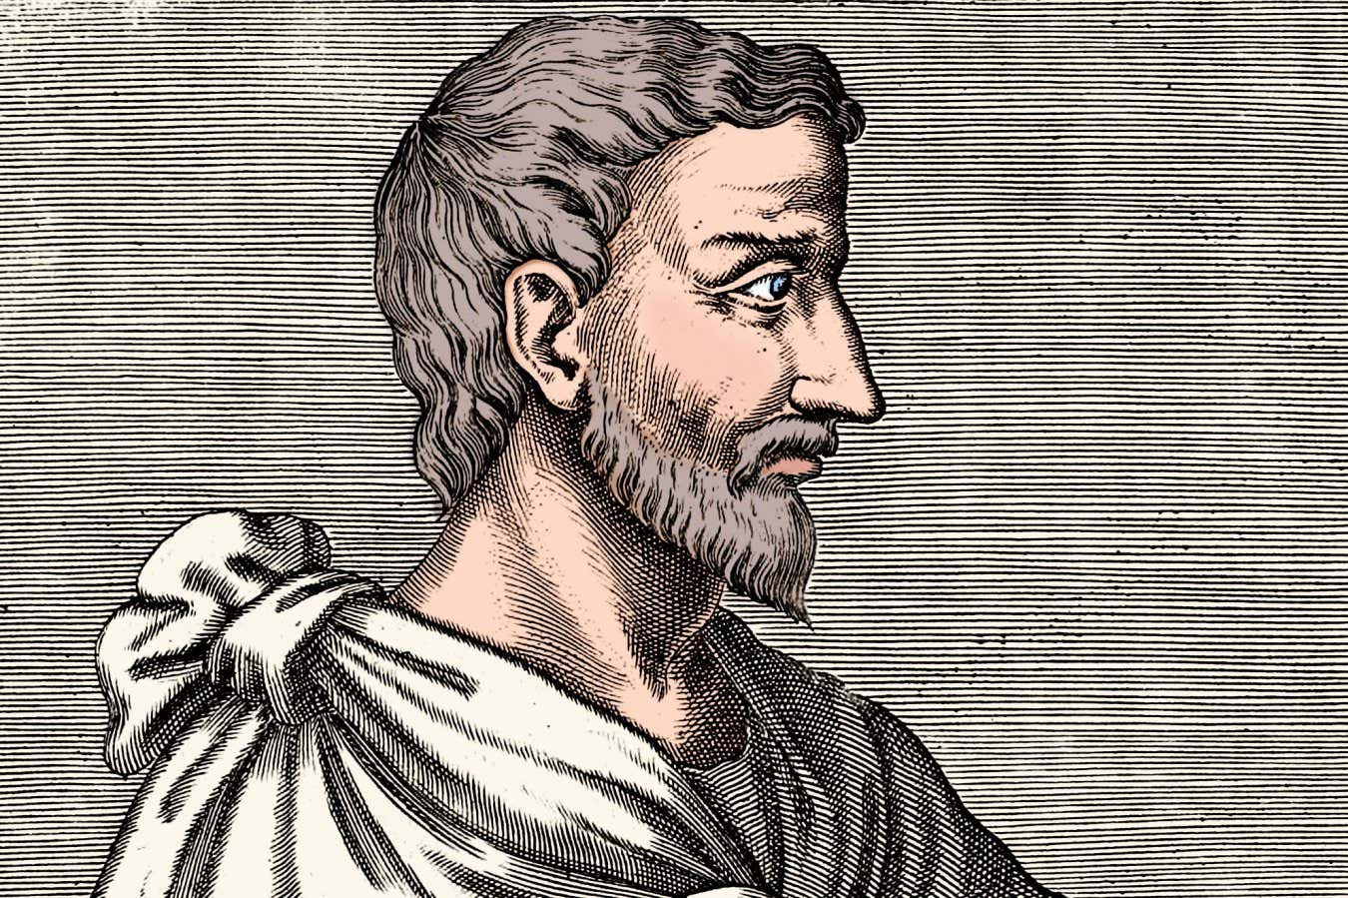

Slide 2

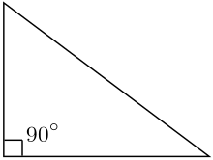
Measure short sides, work out hypotenuse and then measure.

Slide 3
Measure hypotenuse and one short side then work out the other short side and then measure to confirm.

Slide 4
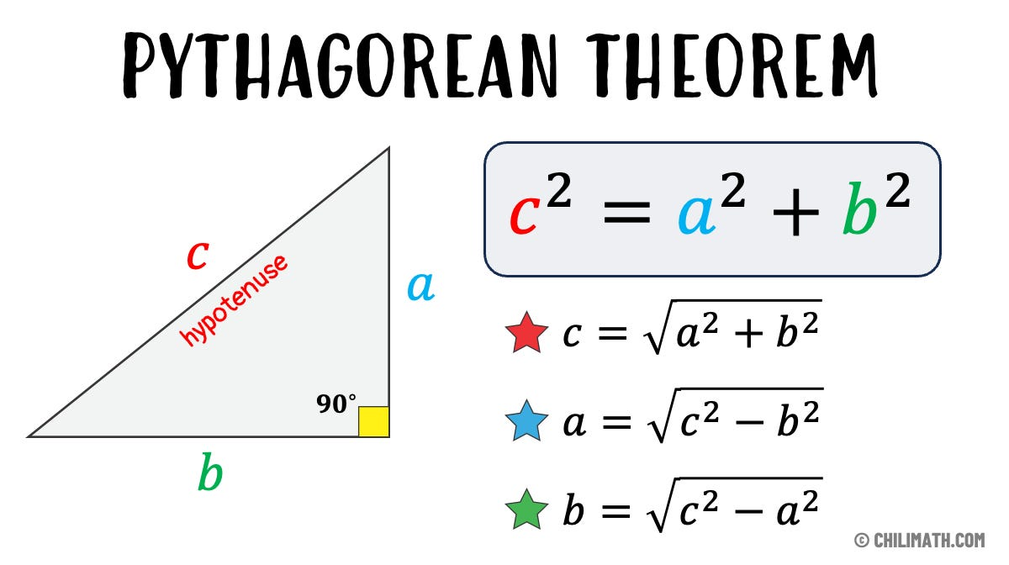

Slide 5

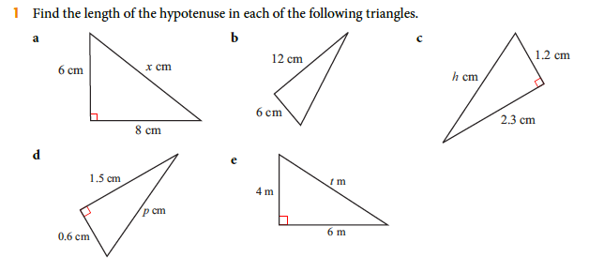
Homework: Ex 11.1 1a-d 2a-d 3a-d
4a-d (p228-229)

Slide 6
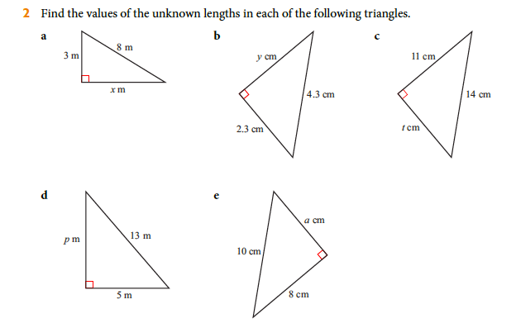
Homework: Ex 11.1 1a-d 2a-d 3a-d
4a-d (p228-229)

Slide 7
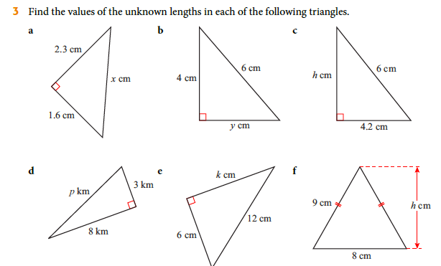
Homework: Ex 11.1 1a-d 2a-d 3a-d
4a-d (p228-229)

Slide 8
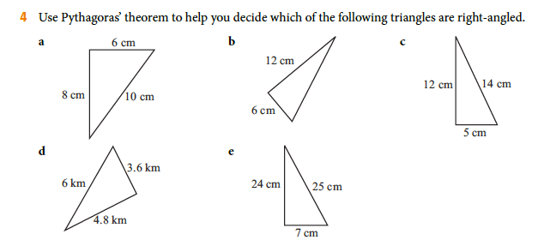
Homework: Ex 11.1 1a-d 2a-d 3a-d
4a-d (p228-229)

Slide 9
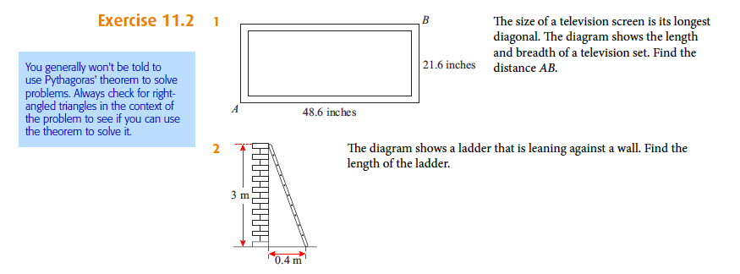
Homework: Ex 11.2 1-5 (p231)

Slide 10
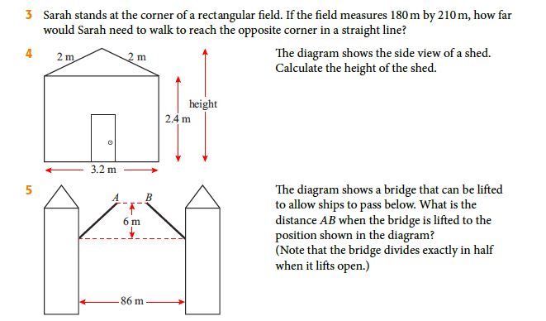
Homework: Ex 11.2 1-5 (p231)

Slide 11
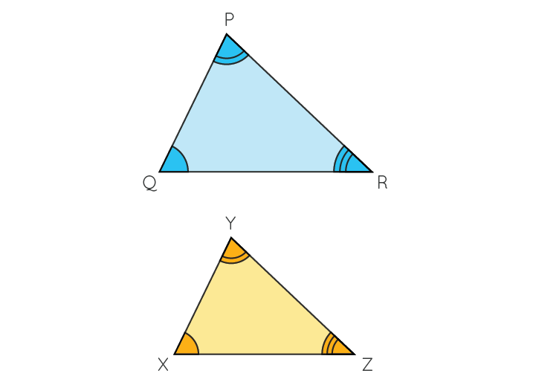
Similar Triangles
Mathematically similar objects have exactly the same shape and proportions, but may be different in size.
1. Corresponding angles are equal
2. “Internal ratios” are the same
3. Corresponding ratios are the same

Slide 12
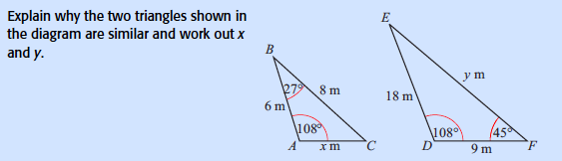

Slide 13
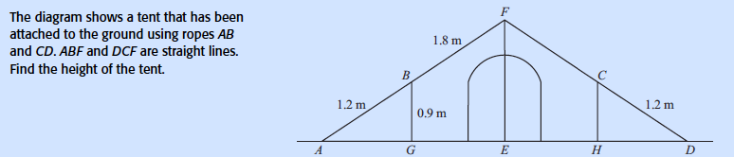

Slide 14

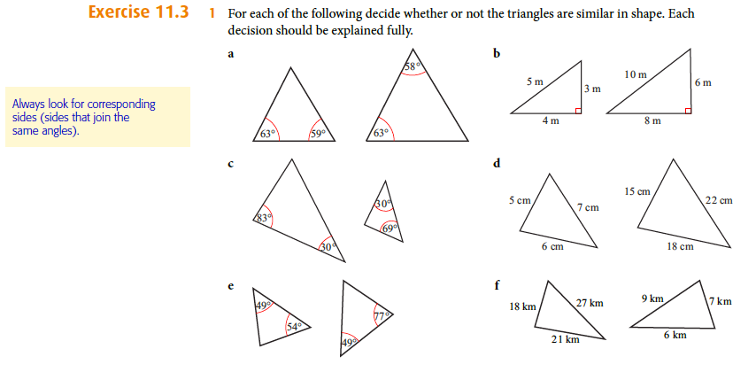
Homework: Ex 11.3 1. (p233)

Slide 15
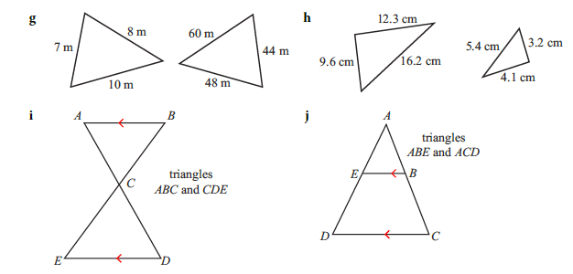
Homework: Ex 11.3 1. (p233)

Slide 16
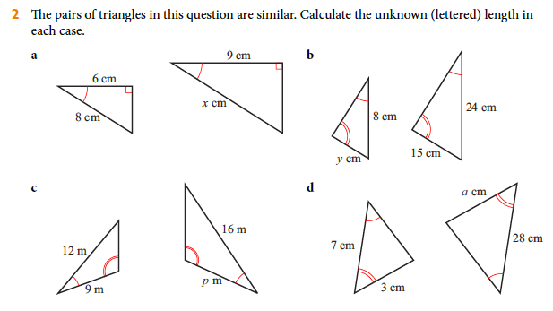
Homework: Ex 11.3 2a-d (p233)

Slide 17
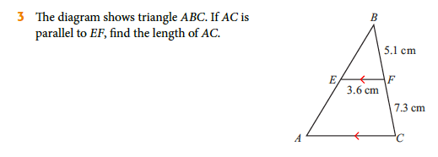
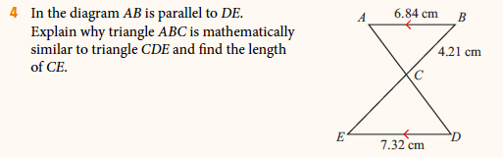
Homework: Ex 11.3 3-5 (p233)

Slide 18
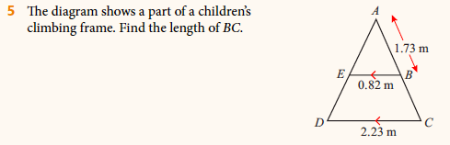
Homework: Ex 11.3 3-5 (p233)

Slide 19
Homework: Ex 23.3 (p565)

Slide 21
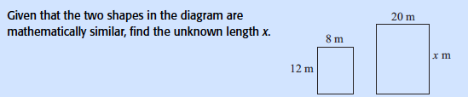

Slide 22
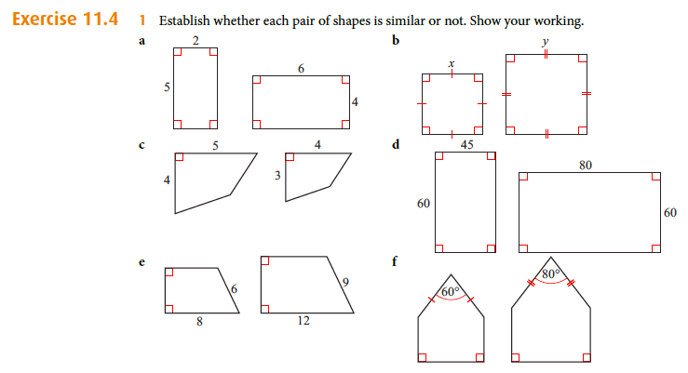
Homework: Ex 11.4 1a-e, 2a-e (p236)

Slide 23
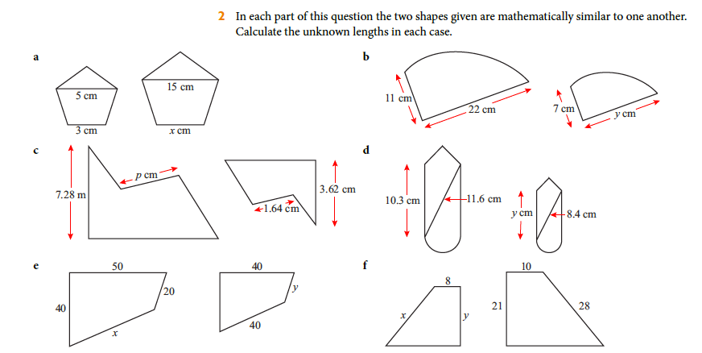
Homework: Ex 11.4 1a-e, 2a-e (p236)

Slide 24


Area and volume of similar shapes

Slide 25


Slide 27
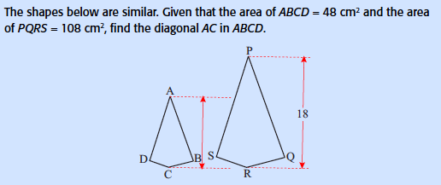

Slide 28
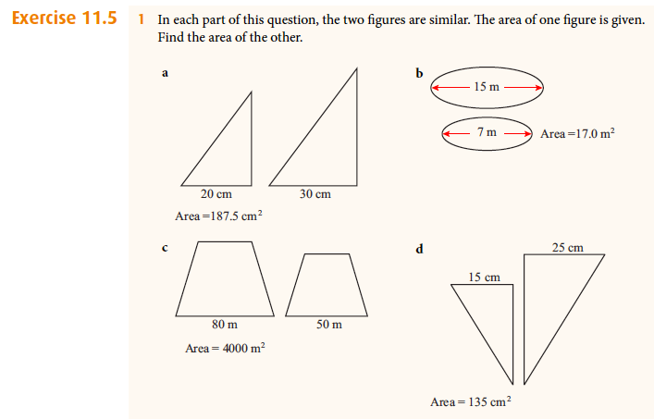
Homework: Ex 11.5 1, 2 (p239)

Slide 29
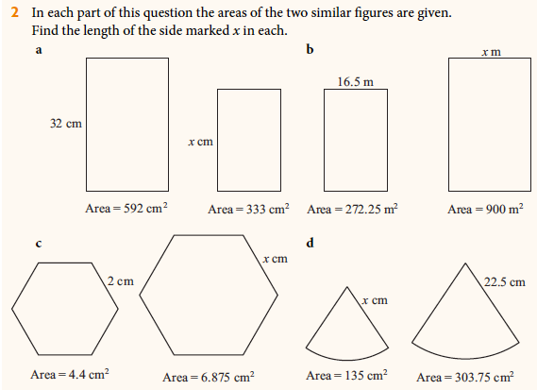
Homework: Ex 11.5 1, 2 (p239)

Slide 30
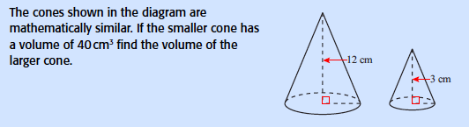

Slide 31
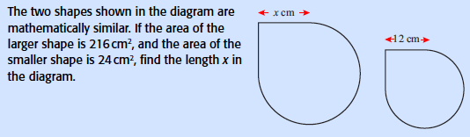

Slide 33
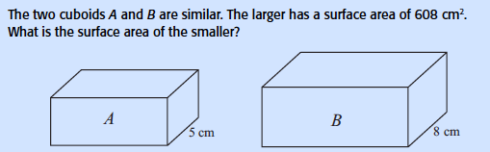

Slide 34
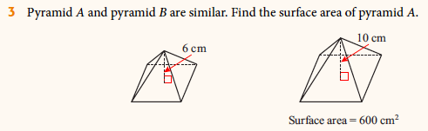
Homework: Ex 11.6 3,6,7 (p242)

Slide 35
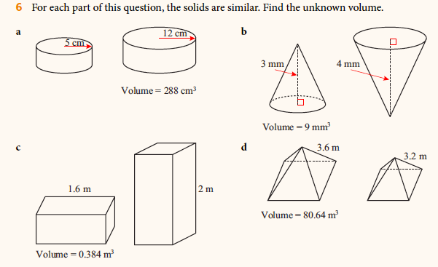
Homework: Ex 11.6 3,6,7 (p242)

Slide 36
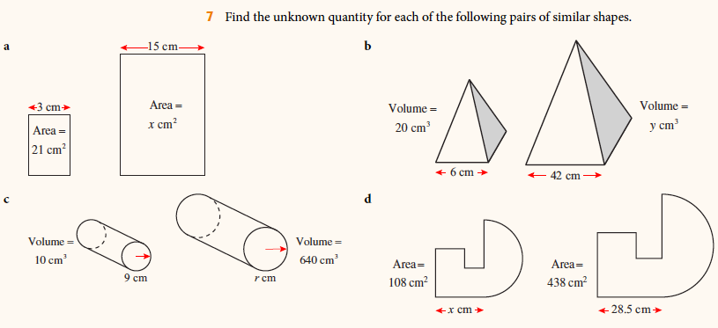
Homework: Ex 11.6 3,6,7 (p242)

Slide 37
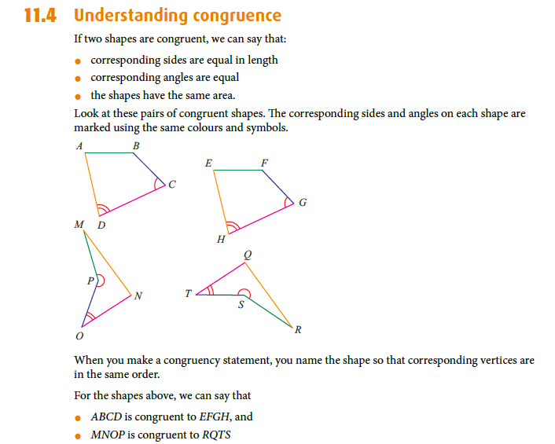

Slide 38
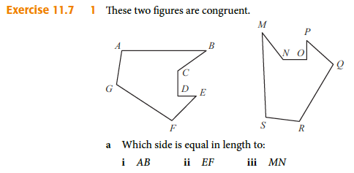

Homework: Ex 11.7 1,3 (p244)

Slide 39
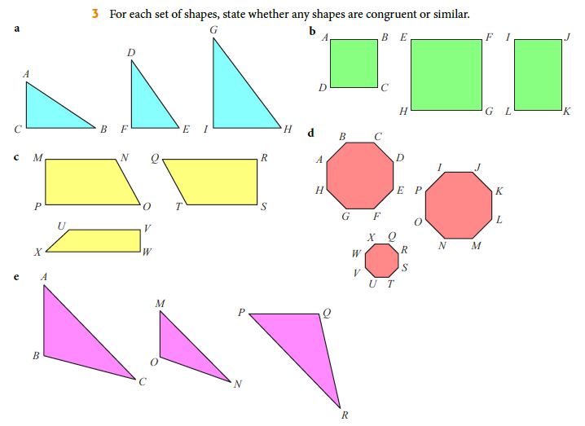
Homework: Ex 11.7 1,3 (p244)

Slide 40
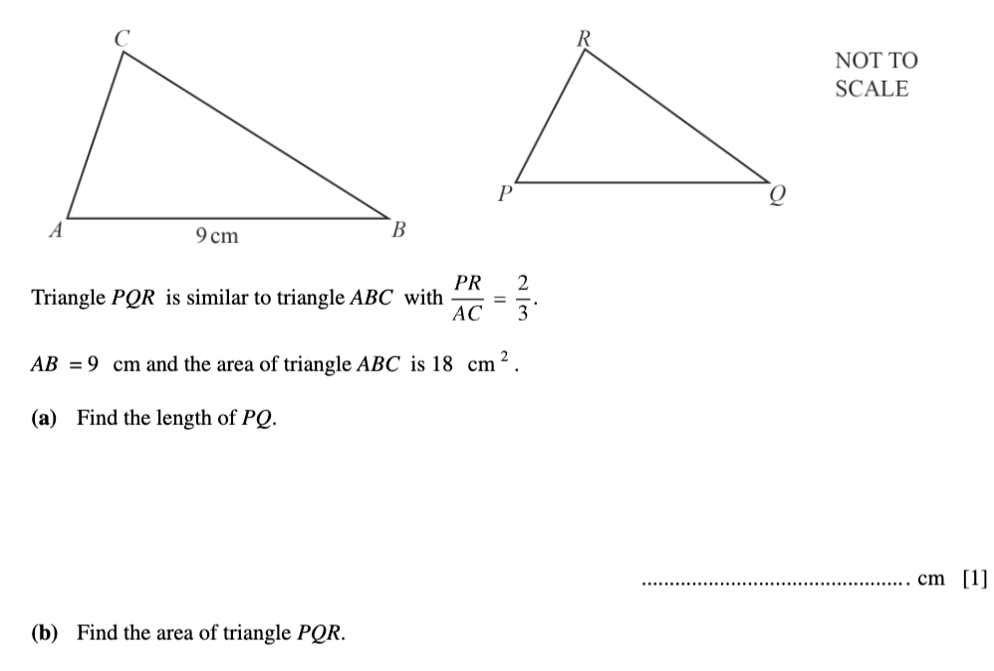
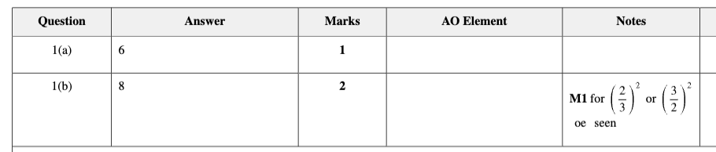

Slide 41
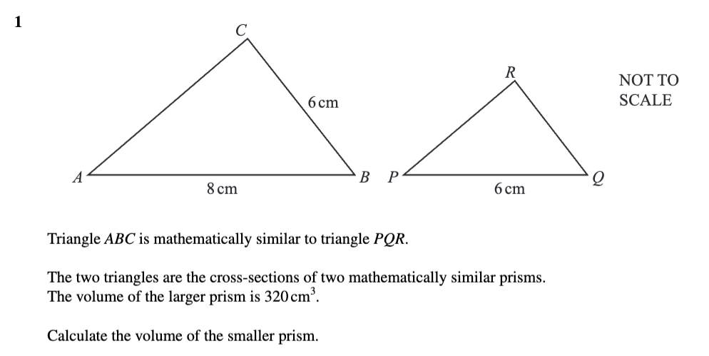
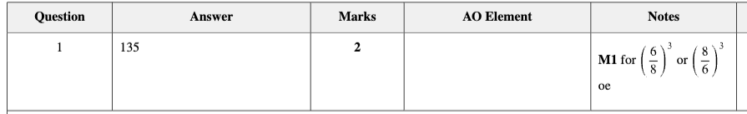

Slide 42
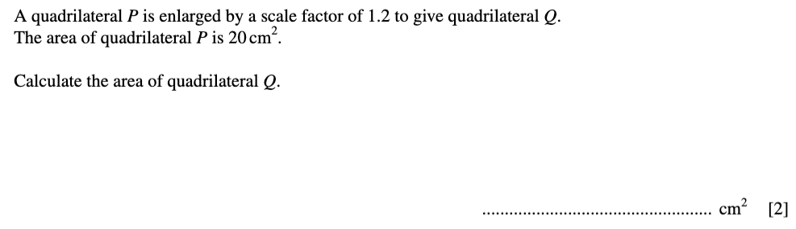
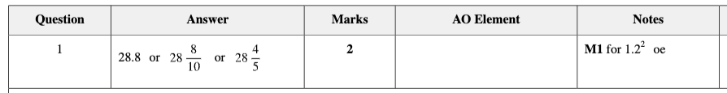

Slide 43
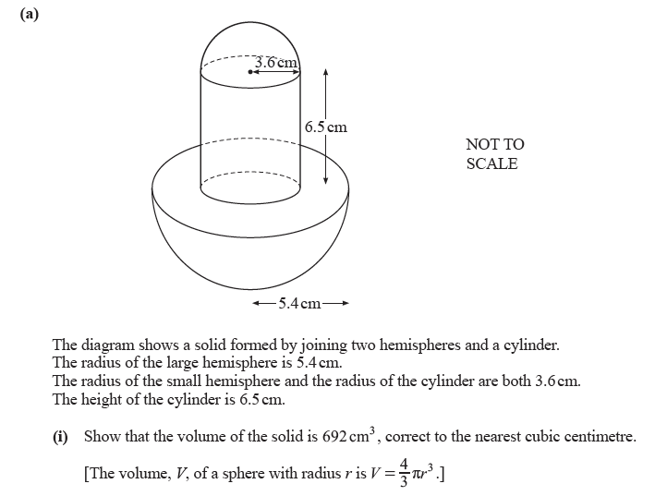
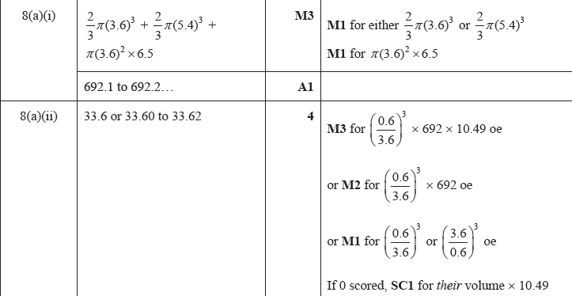
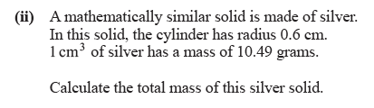

Slide 44
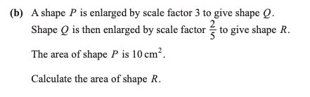
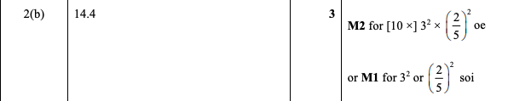

Slide 45
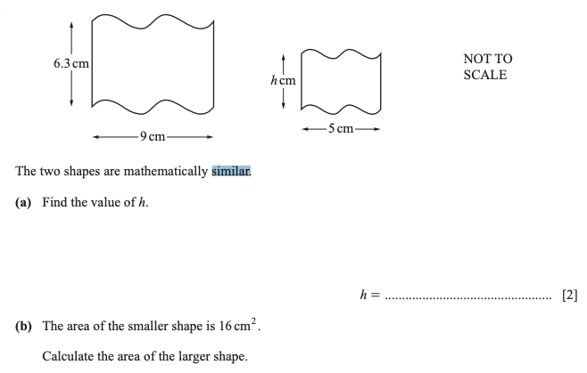
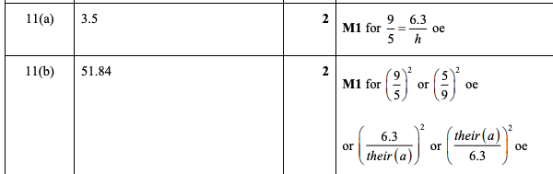

Slide 46
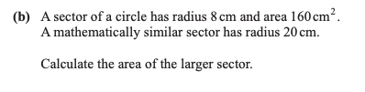
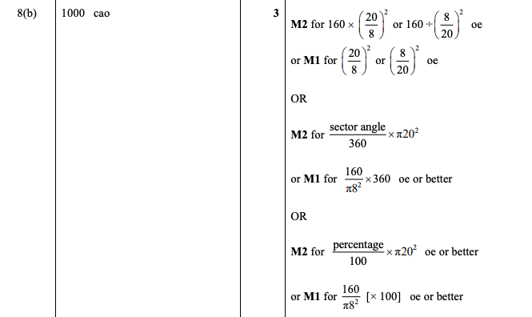

Slide 47
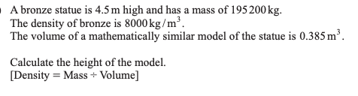
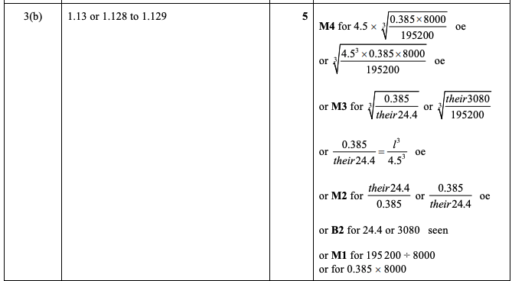

Slide 48

Whiteboard time

